Slide 1

Machine Learning Best Practices with Alfresco & Activiti
Jason Jolley
Notes:
Hi There! My name is Jason Jolley. I am the Director of Application Development for Micro Strategies – A US based Alfresco partner. Today I’d like to talk about Machine Learning Best Practices with Alfresco and Activiti.
Please don’t hesitate to ask questions as we go through the presentation.

Slide 2
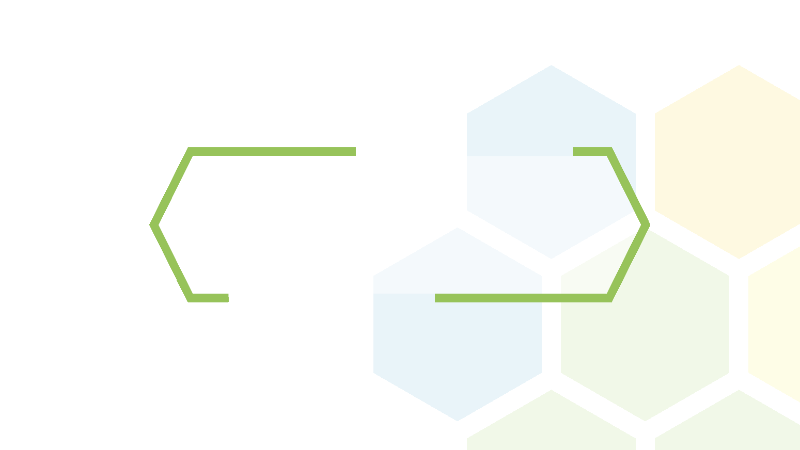
Goal

Slide 3

Empower everyone to use Machine Learning in Content and Process Services.
Notes:
By the end of this session I hope you will have enough information to get started building your own solutions.

Slide 4
Want to build your own Cognitive Process?
Download an Activiti Enterprise Trial
Sign up for a free IBM BlueMix Account [No Credit Card Required]
Configure an Activiti Endpoint to the BlueMix Watson service of your choosing.
Enjoy!
You will be able to create your very own Cognitive Process POC without writing any code!
Back to this near the end of the presentation
Notes:
How many of you have worked with Activiti Enterprise?
Before we get to deep – here is some very high level instructions on how to get setup. While this session isn’t a tutorial – if you are so inclined, you can get started with Cognitive Services while we are talking

Slide 5
Agenda

Slide 6
Agenda
Machine Learning Overview
Common Tools & Services
Patterns Applied to Alfresco and Activiti

Slide 7
Machine Learning?

Slide 8

What is Machine Learning?
An Overused Buzzword
A Transformative Technology
A Confusing Mess
All of the above

Slide 9
What is Machine Learning?
“A field of study that gives computers the ability to learn
without being explicitly programmed.”
-Dr. Arthur Samuel
Think: “The algorithms to accomplish a task.”

Slide 10
What about “Cognitive Computing”?
For most of us – Machine Learning and Cognitive Computing are analogous.
Cognitive computing leverages machine learning and other AI to emulate Human Cognition.
Most of the major vendors now brand themselves with ‘Cognitive Services’

Slide 11
How does it relate to Content & Process Services?
Content & Process Services deal with unstructured content! Sometimes, A LOT of unstructured content!
Today’s cognitive processes LOVE unstructured content.

Slide 12


“Ready to Go” Cognitive Services API

Slide 13
Common APIs
Natural Language Processing
Tone Analysis
Personality Insights
Visual Processing
Document Conversion
Language Translation
Speech
There are commonalities in various Cognitive Services
Each API is independent.
Best Practice: Mix and Match the APIs for your the solution

Slide 14
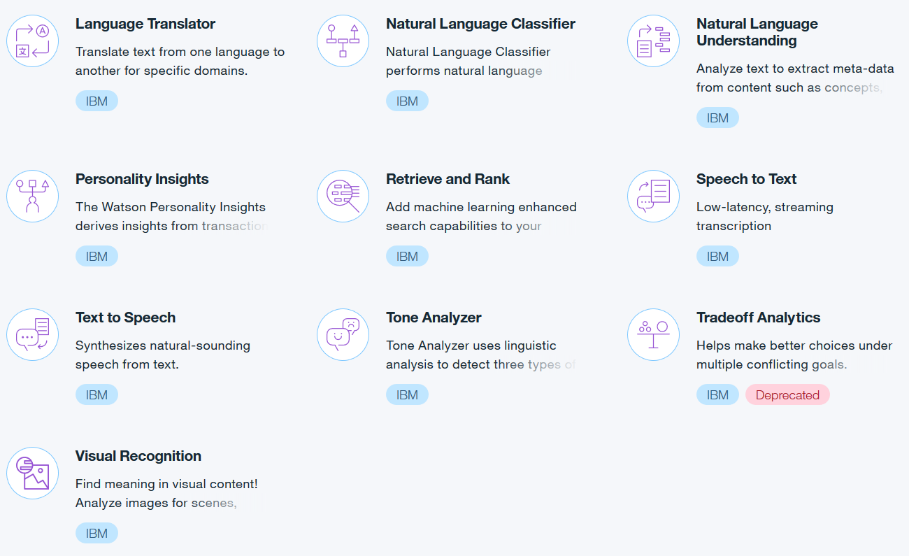
Watson Services (Part of IBM BlueMix)

Slide 15
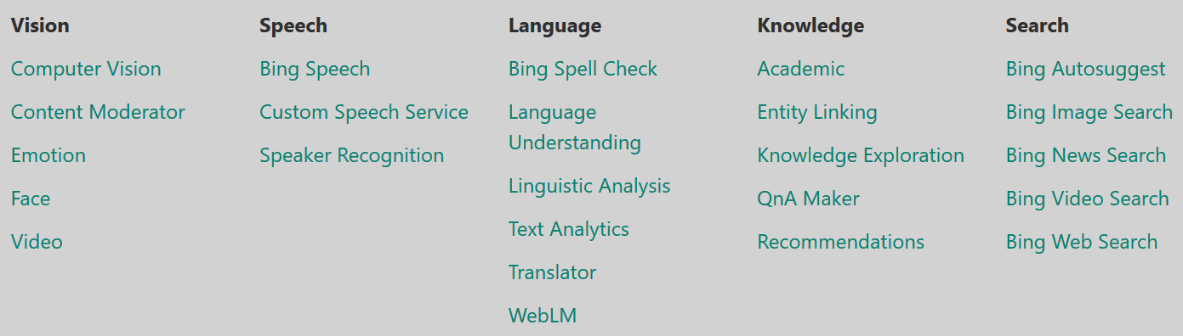
Microsoft Cognitive Services

Slide 16
Natural Language Processing (NLP)

Slide 17

NLP

Slide 18
Natural Language Processing
Analyzes Unstructured Text to extract items like:
Key Phrases
Entities
Categories
Concept
Topics
Language Detection
Semantic Roles
Emotion
Sentiment

Slide 19
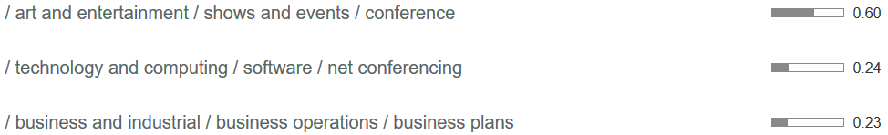
NLP Example: http://www.beecon.buzz
Sentiment
Note: All Scores are between 0.00 and 1.00
Entities
Emotion
Categories

Slide 20
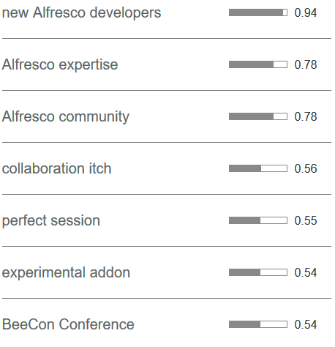
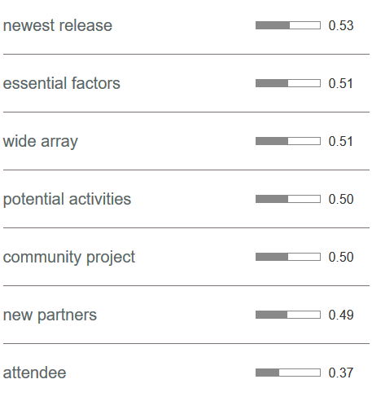
NLP Example: http://www.beecon.buzz
Keywords
Keywords

Slide 21
NLP Use Cases with Content & Process Services
Too Many Uses Cases!
Bulk Document Classification & Re-organization
Inbound Document Parsing
Automatic Categorization & Tagging of Content
Automatic Folder creation and document relocation
Process Decisions
Issue Escalation
And many more….
Best Practice: Mix and Match the APIs for your the solution
Notes:
More : Conflict Analysis

Slide 22
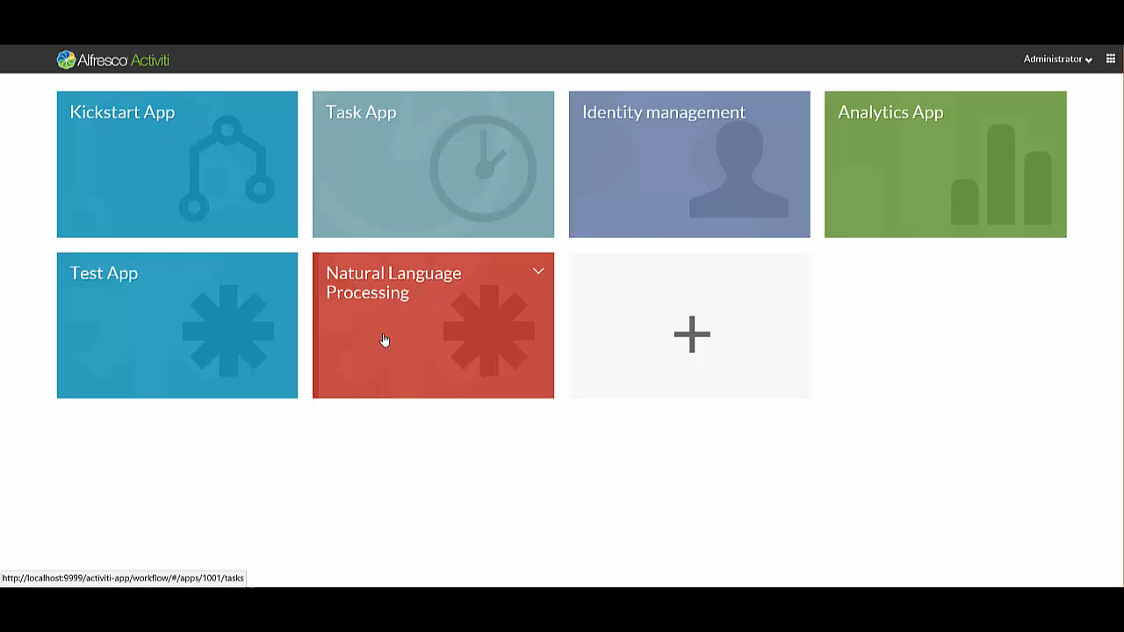
NLP Demo

Slide 23
NLP Demo

Slide 24
Visual Recognition

Slide 25
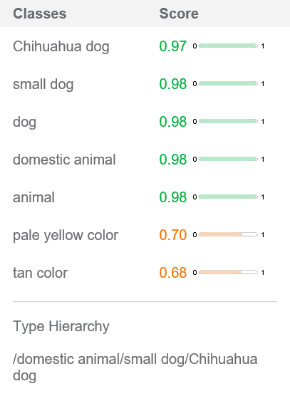

Visual Recognition
Visual Recognition uses deep learning algorithms to analyze images that can give you insights into your visual content.
Object Classification
Face Detection

Slide 26
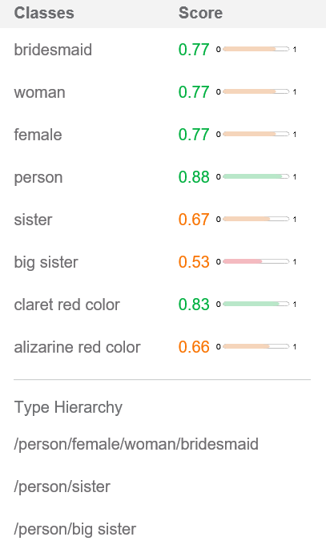
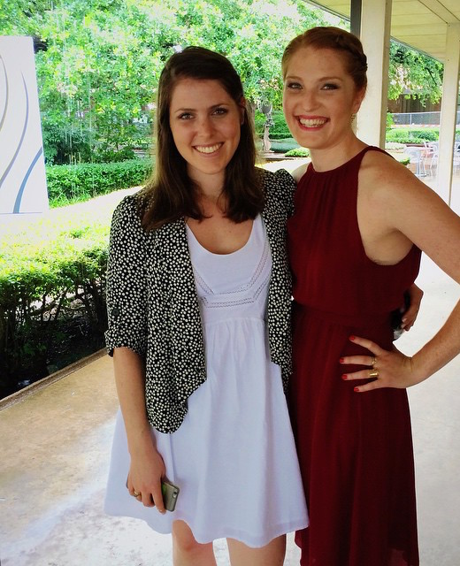
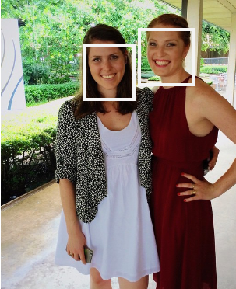
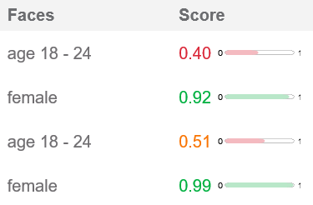
Visual Recognition
Visual Recognition uses deep learning algorithms to analyze images that can give you insights into your visual content.
Object Classification
Face Detection

Slide 27
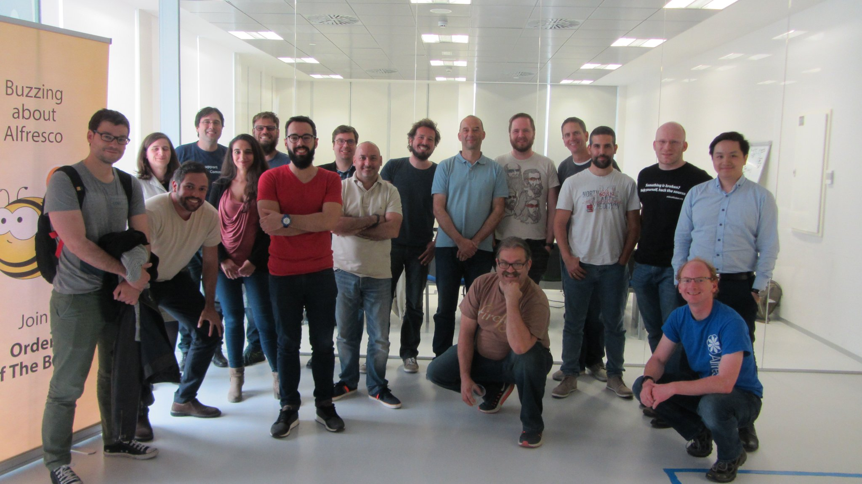
Beecon Hackathon

Slide 28
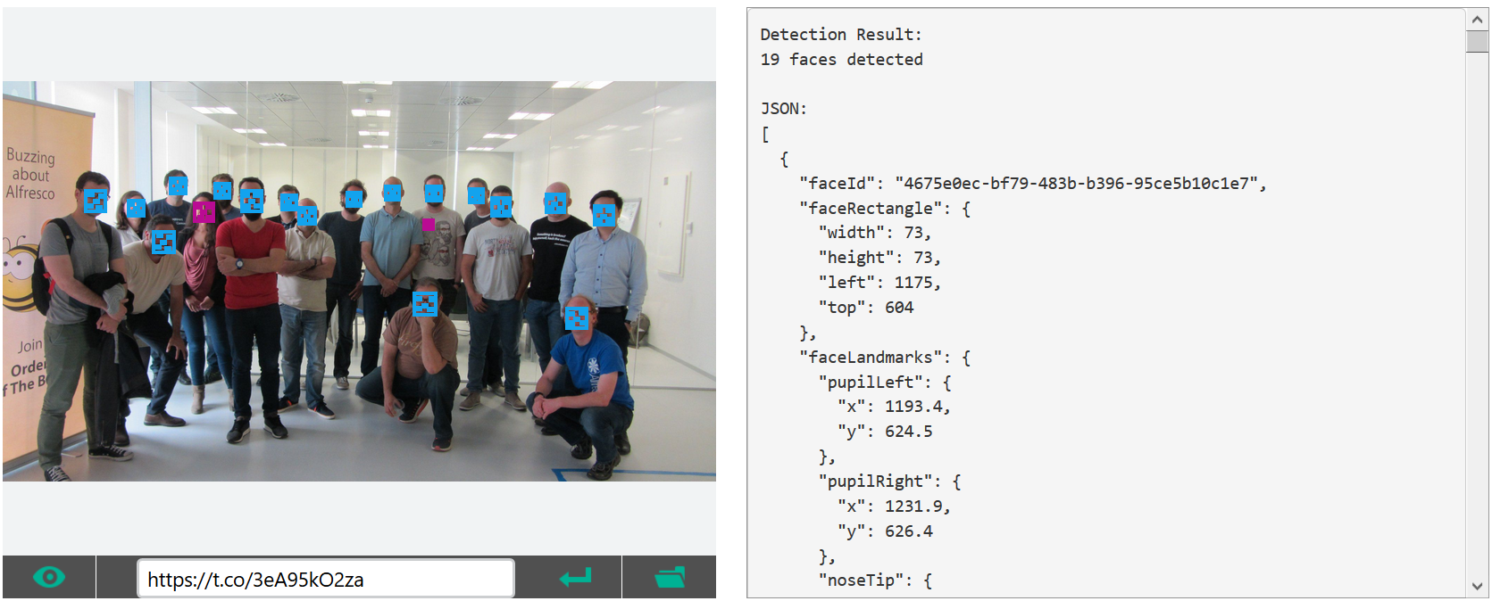
Beecon Hackathon
160 attendees from all over the world

Slide 29
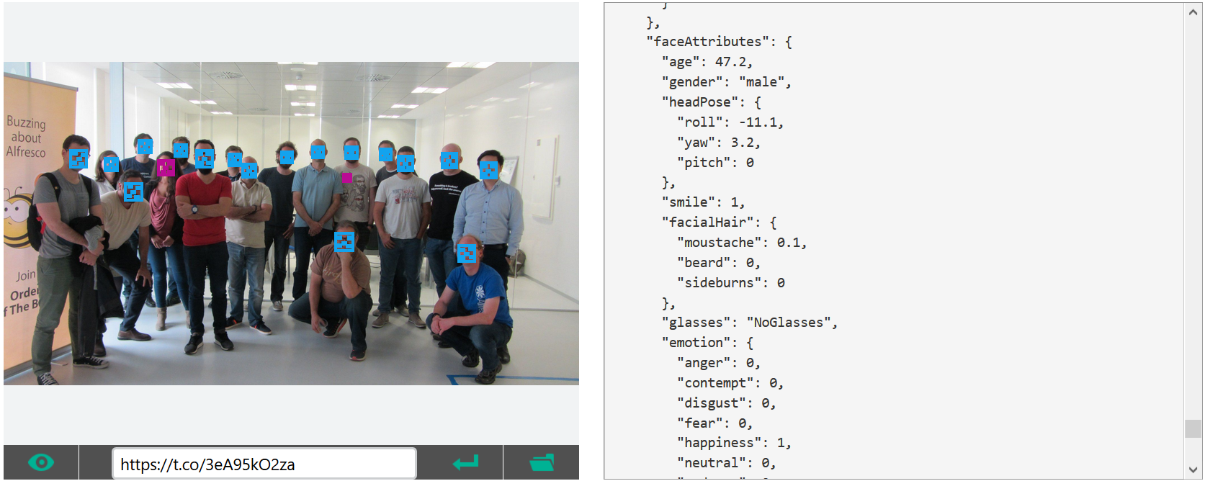
Beecon Hackathon
160 attendees from all over the world

Slide 30


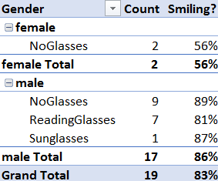


Some Hackathon Stats

Slide 31
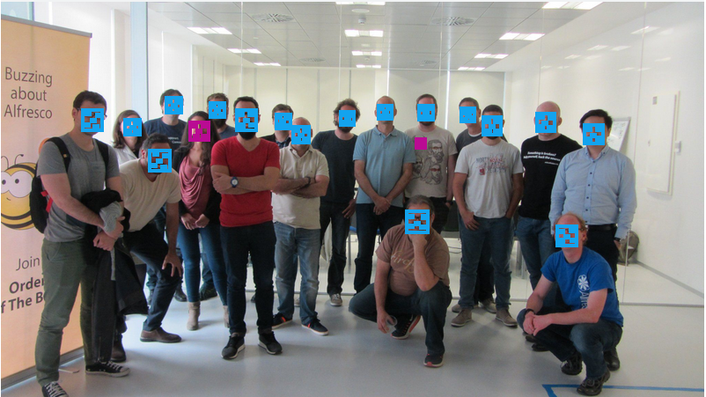
Some Hackathon Stats
WAIT!!! Who is that?
Notes:
Imagine walking into a department store. There is a camera that takes your picture as you enter and analyzes your gender, age, even emotion. Then – a TV screen display products marketed directly to you personally.
This is real world functionality that is easy to implement, and will soon be commonplace.
A Valuable lesson learned
Cognitive Computing is GREAT at making generalizations. But – it can be fooled. Everything is rated on a confidence scale. 100% confidence is rare.

Slide 32
Tone Analysis

Slide 33





Tone Analysis
Detect and interpret emotions, social tendencies, and language style cues found in text.
Fear
Sad
Disgust
Joy
Anger
Sentiment Analysis
0
1
Negative
0.5
Positive

Slide 34
Use Case – JIRA & Customer Service
We use JIRA to help service our clients.
Customer Response Time is VERY Important.
BUT – Even More Important is Customer Satisfaction!
Response Time is easy to measure.
How do you automatically measure Customer Satisfaction?

Slide 35
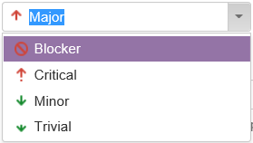
Use Case – JIRA & Customer Service
Customers can choose Priority…
Priority != Satisfaction
A Customer could log a Trivial issue, but still be very dis-satisfied.

Slide 36


Use Case – JIRA & Customer Service
Customer Enters JIRA Ticket
Activiti Calls Watson
Watson Analyzes Sentiment & Emotion:
Summary
Description
Comments
Activiti notifies Stakeholders if thresholds are exceeded.
Stores Data for reporting.
Notes:
Technically
JIRA has a webhook that can call a RESTful service.
The Webhook calls a custom service that passes the Summary, Description and/or comments to a new Activiti process.
Activiti – using a REST Call Task (or a custom service) – calls Watson with the text.
Watson analyses it and provides a score back to Activiti
Activiti decides what to do next

Slide 37
Use Case – JIRA & Customer Service
Some tips:
Start Small – a Test Project, then a small project
Configurable Thresholds
Save historical data for trends. Consider using trends for alerts instead of individual tickets.

Slide 38
Configuration - Demo

Slide 39
THANK YOU!!! Jason Jolley
jjolley@microstrat.com
@jasonjolley

